Slide 1
AP157 Module 3: Dimensionality Reduction
May 25, 2022

Slide 2
Outline
Curse of Dimensionality
Dimensionality Reduction in Machine Learning
Principal Component Analysis (PCA)
Introduction
Derivation
Example
Lab Assignment: PCA of SDSS Galaxy Spectra

Slide 3
The Curse of Dimensionality
"As the number of features or dimensions grows, the amount of data we need to generalize accurately grows exponentially."
- Charles Isbell, Professor and Senior Associate Dean, School of Interactive Computing, Georgia Tech
In data analysis/machine learning, the number of dimensions (input features) determine the ff.:
Size of data required to constrain a model
Complexity of the model itself
Search times required to optimize the model
-> Solution: Dimensionality Reduction - finding projections within the data that capture the principal physical and statistical correlations between measured quantities

Slide 4
Dimensionality Reduction in Machine Learning
Dimensionality reduction is the process of reducing the dimension of your feature set
e.g., from a dataset with 100 columns to around 20
Can be part of the ff. steps in the machine learning process:
Feature selection - the process of identifying and selecting relevant features for your sample
Feature engineering - manually generating new features from existing features, by applying some transformation or operation on them
Some popular algorithms for dimensionality reduction:
Principal Component Analysis (PCA)
Factor Analysis
Linear Discriminant Analysis (LDA)
https://towardsdatascience.com/dimensionality-reduction-for-machine-learning-80a46c2ebb7e

Slide 5
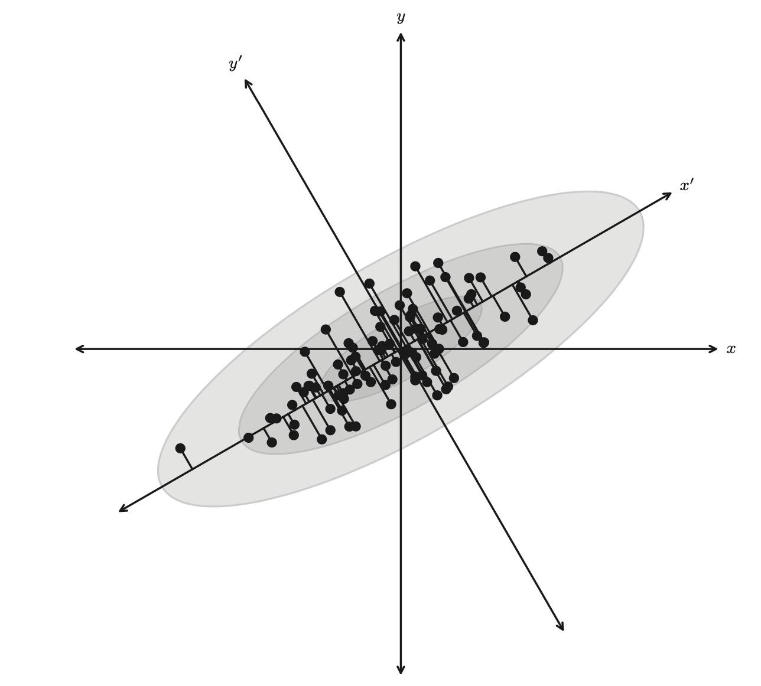
Principal Component Analysis (PCA)
A linear transform that defines a set of uncorrelated axes (the principal components) ordered by the variance captured by each new axis
In the example on the right, axes are rotated to align with the correlation in the data, to maximize the ability to discriminate between the data points
The new axes are aligned with the direction of maximum variance within the data (the direction with the maximum signal).
A distribution of points drawn from a bivariate Gaussian and centered on the origin of x and y. PCA defines a rotation such that the new axes (x′ and y′) are aligned along the directions of maximal variance (the principal components) with zero covariance. (Figure 7.2 in SDMMLA)

Slide 6
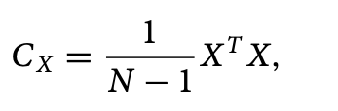
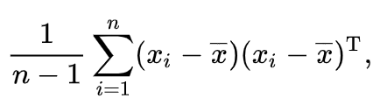
Derivation of PCA
Consider a set of data, {x_{i}}, comprising a series of N observations with each observation made up of K measured features
We initially center the data by subtracting the mean of each feature in {x_{i}} and then write this N × K matrix as X
The covariance of the centered data, C_{X} , is given by
N.B. Since X is centered data, this can be written out as:

Slide 7

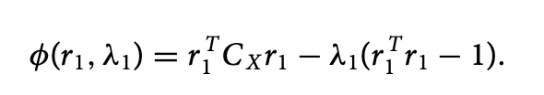
Derivation of PCA (cont.)
PCA wishes to identify a projection of {x_{i}}, say, R, that is aligned with the directions of maximal variance. We write this projection as Y = XR and its covariance as
The first principal component, r₁, of R is defined as the projection with the maximal variance (subject to the constraint that r₁^{T}r₁ = 1).
We can derive this principal component by using Lagrange multipliers and defining the cost function, φ(r₁,λ), as

Slide 8


Derivation of PCA (cont.)
Setting the derivative of φ(r₁, λ) (with respect to r₁) to zero gives
λ₁ is, therefore, the root of the equation det(C_{X} − λ₁ I) = 0 and is an eigenvalue of the covariance matrix.
The variance for the first principal component is maximized when
is the largest eigenvalue of the covariance matrix.

Slide 9

Derivation of PCA (cont.)
The second (and further) principal components can be derived in an analogous manner by applying the additional constraint to the cost function that the principal components are uncorrelated (e.g., r₂^{T}C_{X}r₁ = 0 ) .
The columns of R are then the eigenvectors or principal components, and the diagonal values of C_{Y} define the amount of variance contained within each component. With
and ordering the eigenvectors by their eigenvalue we can define the set principal components for X.

Slide 10
Example: Place ratings dataset
Dataset: Places Rated Almanac data (Boyer and Savageau) which rates 329 communities according to nine criteria:
Climate and Terrain
Housing
Health Care & Environment
Crime
Transportation
Education
The Arts
Recreation
Economics
Source: https://online.stat.psu.edu/stat505/lesson/11/11.3

Slide 11
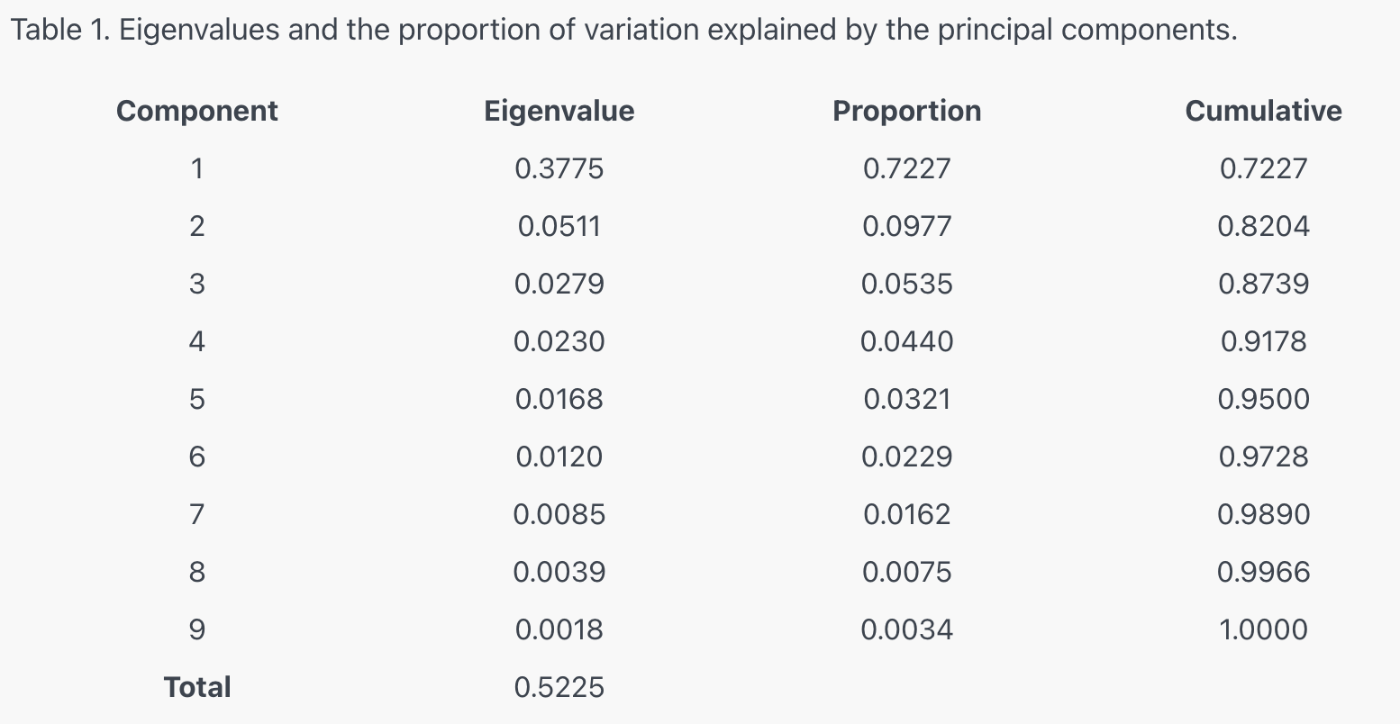
Step 1: Examine the eigenvalues & determine the number of principal components to consider
The first three principal components explain 87% of the variation. This is an acceptably large percentage.

Slide 12
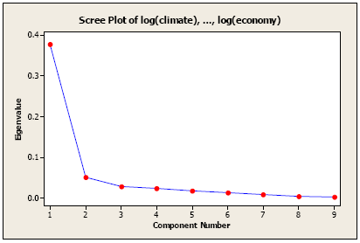
Step 1: Examine the eigenvalues & determine the number of principal components to consider
A scree plot shows eigenvalues vs. number, ordered from largest to smallest
The number of components is determined at the point beyond which the remaining eigenvalues are all relatively small and of comparable size.

Slide 13
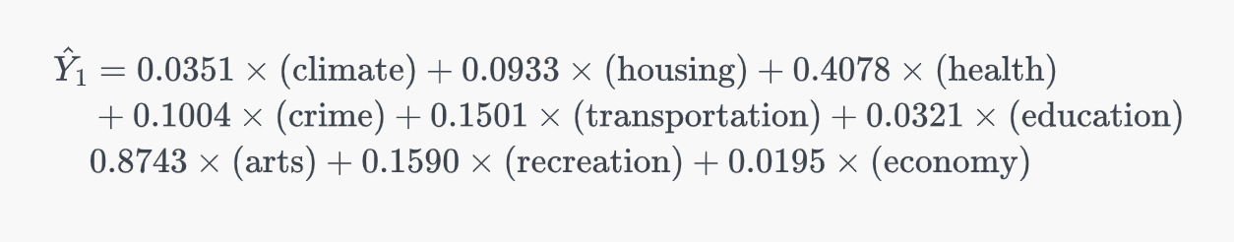
Step 2: Compute the principal component scores
The first principal component can be computed using the elements of the first eigenvector:
To get the score of each individual community (i.e., the new feature), plug in the community's values for each of these variables.

Slide 14
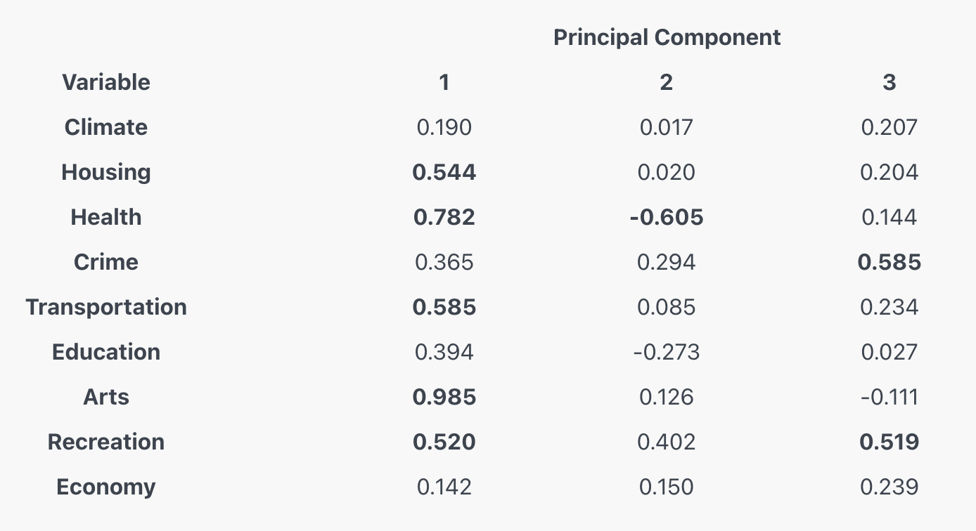
Step 3: Interpret the principal components
To do this, we compute the correlations between the original data and each principal component. Table shows the correlations between the first 3 principal components and the original variables:
Interpretation of the principal components is based on finding which variables are most strongly correlated with each component
Here, a rule of thumb applied is that magnitude of 0.5 is considered large
Notes:
The first principal component is strongly correlated with five of the original variables. The first principal component increases with increasing Arts, Health, Transportation, Housing and Recreation scores. This suggests that these five criteria vary together. If one increases, then the remaining ones tend to increase as well. This component can be viewed as a measure of the quality of Arts, Health, Transportation, and Recreation, and the lack of quality in Housing (recall that high values for Housing are bad). Furthermore, we see that the first principal component correlates most strongly with the Arts. In fact, we could state that based on the correlation of 0.985 that this principal component is primarily a measure of the Arts. It would follow that communities with high values tend to have a lot of arts available, in terms of theaters, orchestras, etc. Whereas communities with small values would have very few of these types of opportunities.

Slide 15
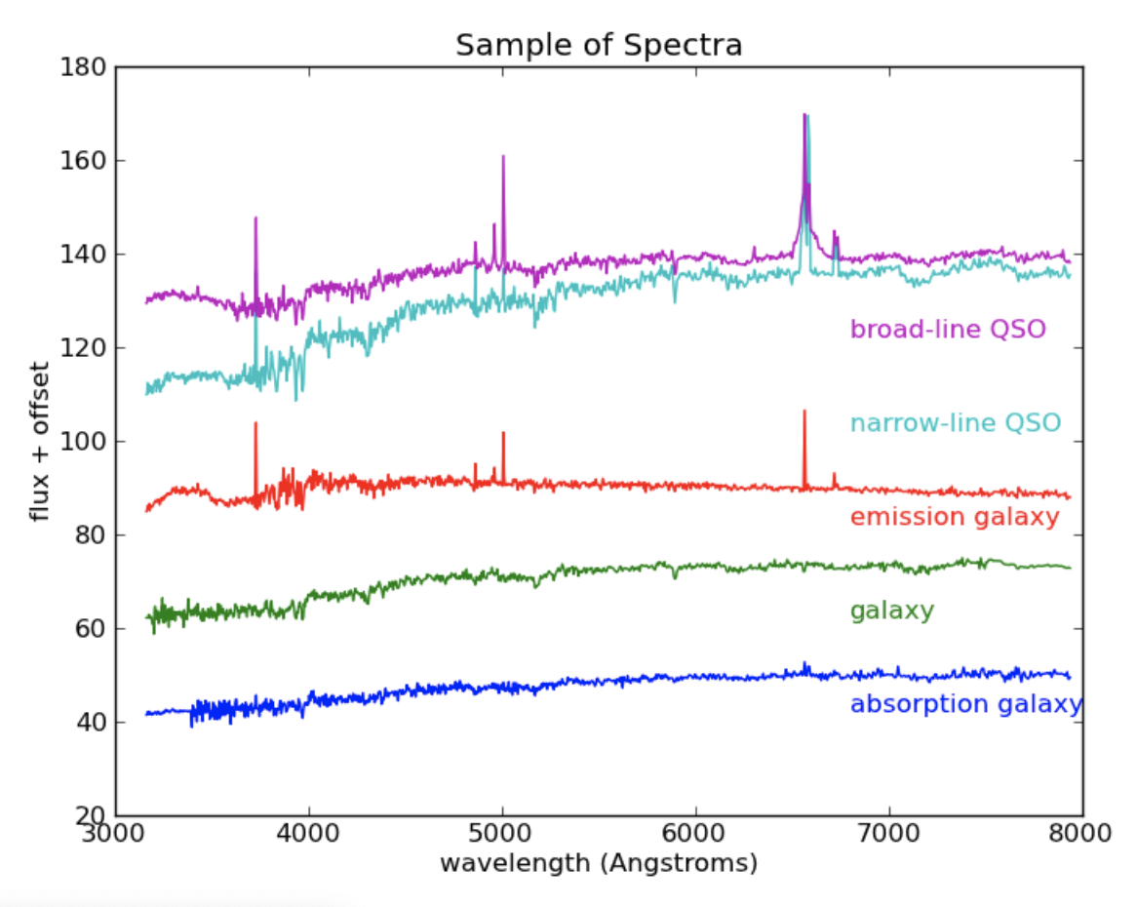
Lab Assignment: PCA of SDSS Galaxy Spectra
Each spectrum covers the interval 3200-7800Å in 1000 wavelength bins.
The spectrum flux(λ) can be represented as a point in D-dimensional space (a D-dimensional vector); in this case, D=1000
https://ogrisel.github.io/scikit-learn.org/sklearn-tutorial/tutorial/astronomy/dimensionality_reduction.html

Slide 16
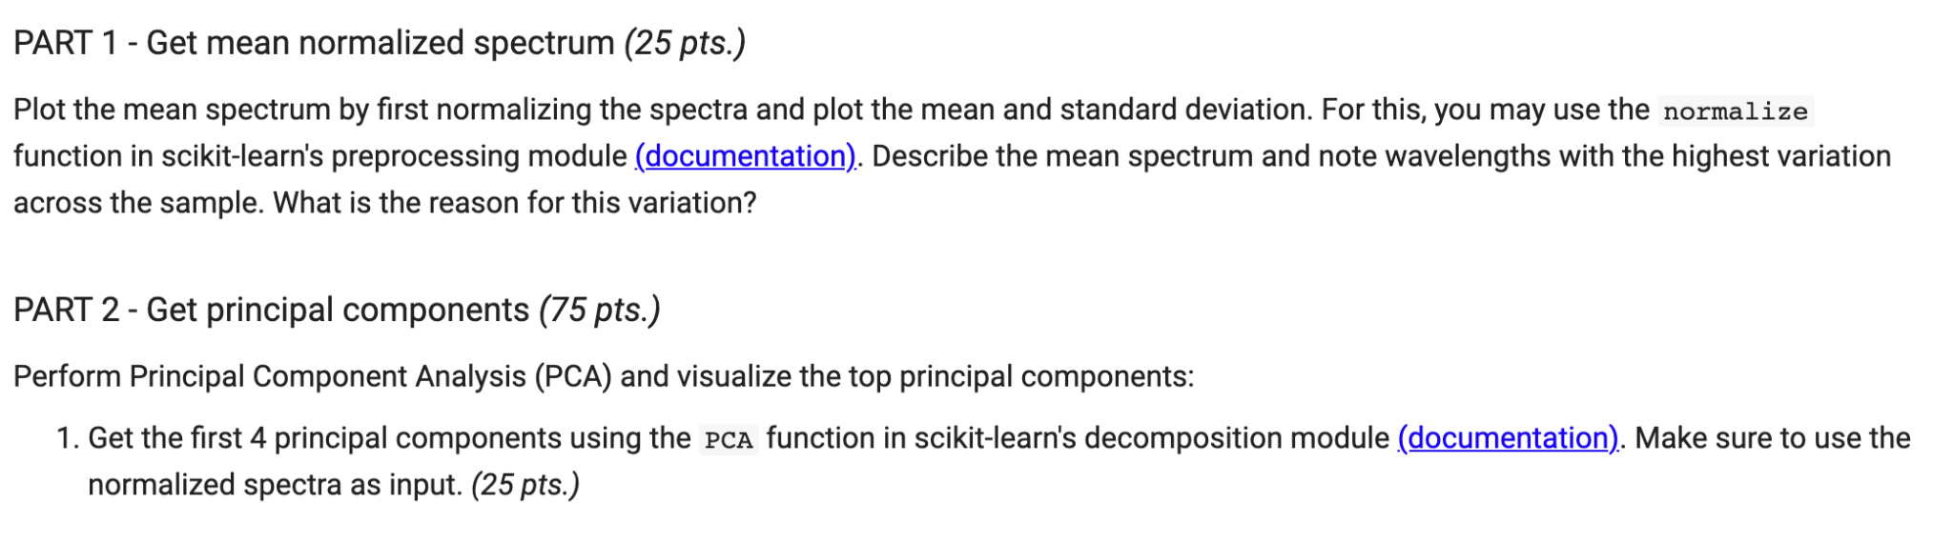
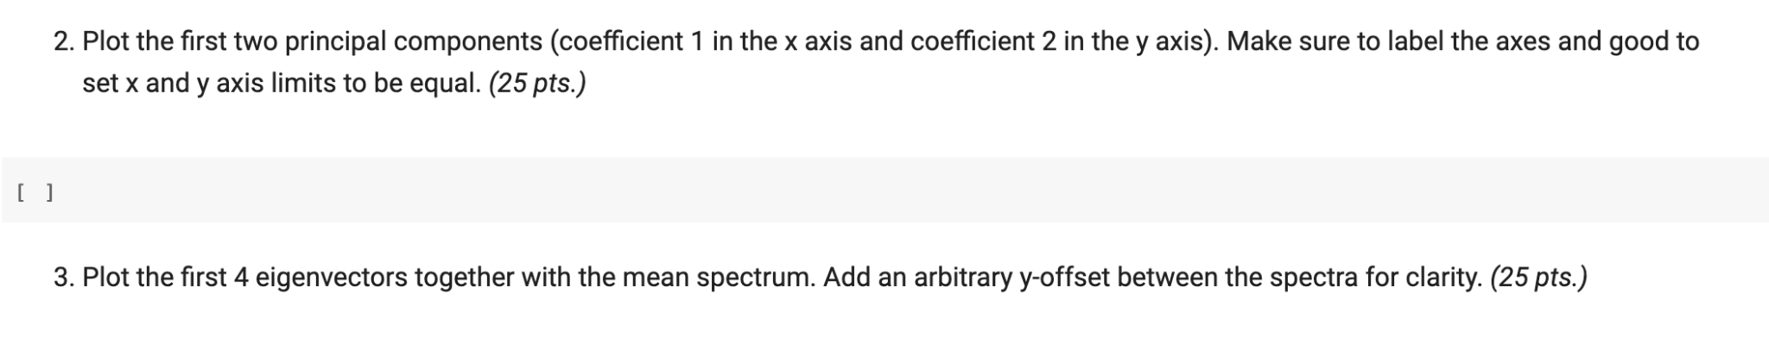
Lab Assignment: PCA of SDSS Galaxy Spectra

